Slide 1
Distributed Mafia Game
CMPE 487 FINAL PROJECT

Slide 2
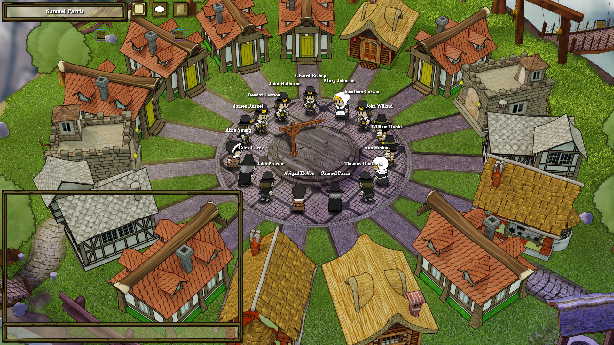
Game Structure
Initiator broadcast will start a game
Other participants join the game
Initiator starts the game
Roles are distributed, which includes doctors, villagers, and vampires
Distributed game mechanics take in

Slide 3
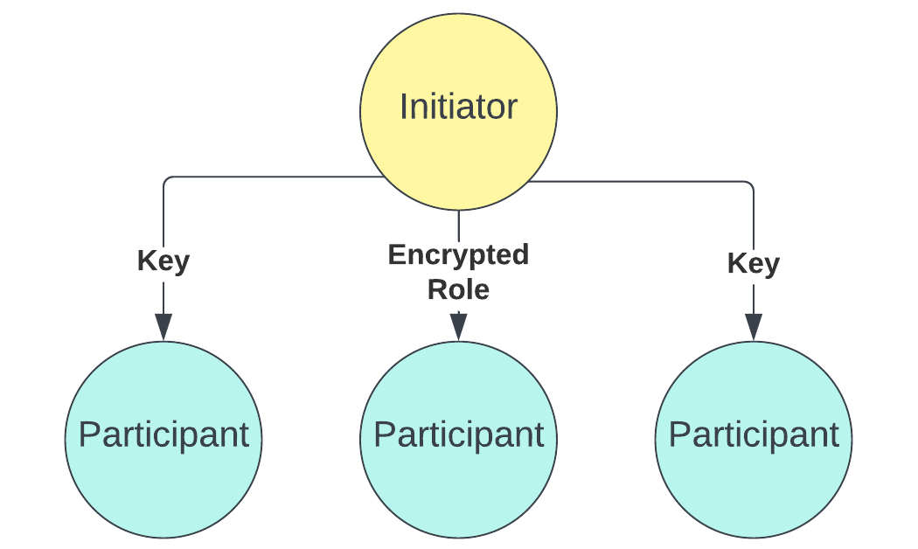
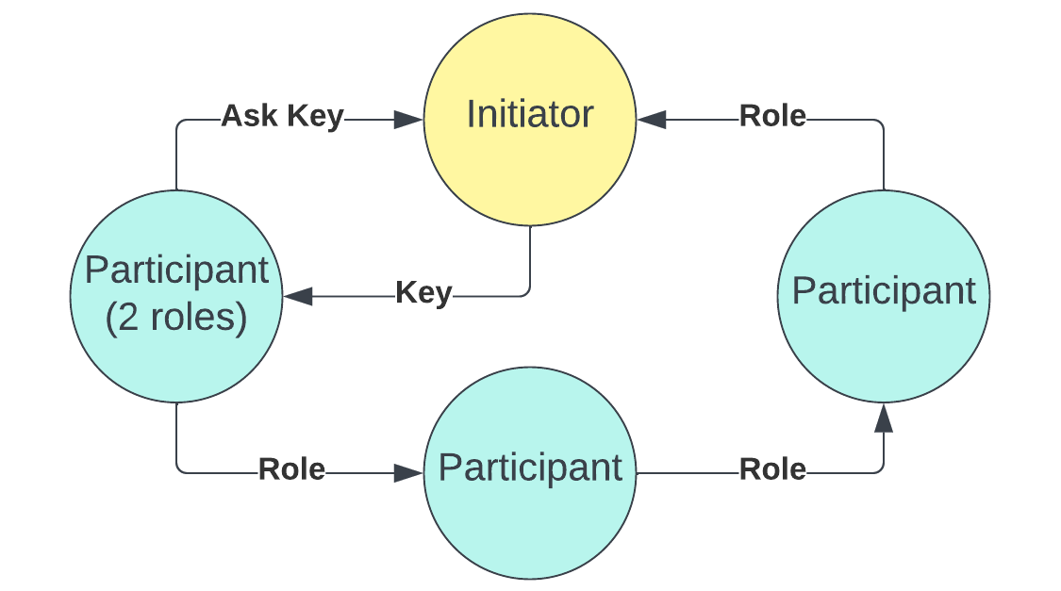
Role Distribution Phase
At stage 0, initiator initiates the game and participants join
At stage 1, initiator distributes roles and keys
At stage 2, other players distribute roles
If exceptional case occurs, players can ask for the role key (with caution)

Slide 4
Game Phase
Day period of 30 seconds
Night period of 10 seconds, where vampires select the participants they will kill
Voting period of 20 seconds.
Vampires can manipulate the voting broadcast of one player.
One player is killed if they get the most votes.
If leading votes are equal, no one is killed.
If vampire count is equal to vilagers’, game is won by vampires. If no vampires left, game is won by villagers.
KILLED PLAYERS MUST BROADCAST THEIR ROLE.

Slide 5
Voting Phase
You practically vote as is:
Broadcasts
Whispers
We first make an intermediate board for the votes, where everyone votes and we keep track of the whispers and broadcasts.
The whispers are propagated immediately by the voter, they first broadcast to all, then whisper each player one-by-one.
After listening the intermediate period, we finalize the votes by looking at the whispers and broadcasts and make the final call for each peer.

